Slide 1
An HMM model would not be an appropriate approach to identify
Named Entities
Part-of-Speech tags
Concepts
Word n-grams
Notes:
Answer D
Word n-grams can be determined by simple algortihmic search. All other types of information are suitable to be modelled using HMMs.

Slide 2
Which statement is correct?
The Viterbi algorithm works because words are independent in a sentence
The Viterbi algorithm works because it is applied to an HMM model that makes an independence assumption on the word dependencies in sentences
The Viterbi algorithm works because it makes an independence assumption on the word dependencies in sentences
The Viterbi algorithm works because it is applied to an HMM model that captures independence of words in a sentence
Notes:
Answer B
All other answers have some logical problem in the formulation. Answer A would imply that works are independent in a sentence, which is clearly wrong. Answer C states that the algorithm makes an independence assumption. The Viterbi algorithm does not make any assumptions to independence, it is applied to an HMM. Therefore Answer C is inaccurate. Answer D is also not exact, since the HMM models does not capture an existing independence, but simply makes the (wrong) assumption that the independence exists.

Slide 3
Which is true?
Hand-written patterns are in general more precise than classifiers
Hand-written patterns cannot exploit syntactic features
Supervised classifiers do not require any human input
Supervised classifiers can only detect typed statements
Notes:
Answer A
Answer B is exactly the opposite of what is the case, that patterns exploit syntactice features. Classifiers requires human input for labelling. They also can be used to detet untyped statements.

Slide 4
Which is true?
Distant supervision requires rules for bootstrapping
Classifiers produced with distant supervision are more precise than rules
Distant supervision can help to detect rules
Notes:
Answer C
Distant supervision does not require and rules, as opposed to bootstrapping. Classifiers from distant supervision tend to be less precise than hand-written rules, though in some cases they achieve comparable performance. Using complex features, distant supervision effectively detects new rules.

Slide 5
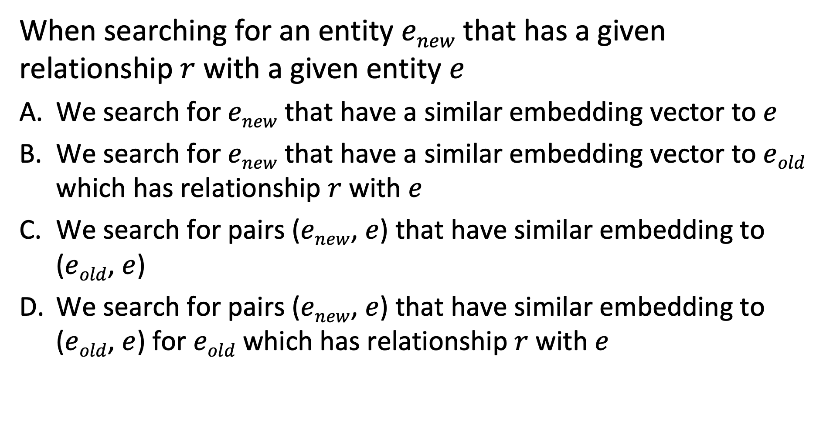
Question
When searching for an entity $enew$ that has a given relationship $r$ with a given entity $e$
We search for $enew$ that have a similar embedding vector to $e$
We search for $enew$ that have a similar embedding vector to $eold$ which has relationship $r$ with $e$
We search for pairs ($enew$, $e$) that have similar embedding to ($eold$, $e$)
We search for pairs ($enew$, $e$) that have similar embedding to ($eold$, $e$) for $eold$ which has relationship $r$ with $e$
Notes:
Answer C
In the model for relation embedding individual entities have no embedding, therefore Answers A and B are not applicable. As for Answer D, it is not required that the existing embedding pairs ($eold$, $e$) have a confirmed relationshi
p. However, we could also search for embeddings of relations r that are similar to the embedding ($enew$, $e$).

Slide 6
If t has no Hypernym ..
It is a root concept
It cannot match c such as t and X
It is identical to the initial root concept
It is a basic concept
Notes:
Answer A
Hypernym means that the concept has no more general concept, therefore it is a root concept. It cannot be part of the pattern from Answer B, since c would be a hypernym of t. In the search for hypernyms differnet root concepts can be found that have no relatino among each other, which excludes Answer C.

